Slide 1
01
Level Up Your Real Estate Digital Marketing
Accelerate Your Real Estate Business with Jonathan Klunk

Slide 2
Why Digital Marketing is King in Today's Market.
02
MORE AGENTS. MORE COMPETITION.
YOUR POTENTIAL CLIENTS ARE ONLINE.
THIS IS YOUR VIRTUAL STORE-FRONT.

Slide 3
Why Listen to This Guy?
#1 AGENT ON SOCIAL IN LOUISVILLE & KENTUCKY
EXPERT DIGITAL MARKETING APPROACH TO REAL ESTATE
UNDENIABLE CLIENT RESULTS
03

Slide 4
3 Pillars to Boost Your Digital Marketing Game
Branding
Social Media
Content Strategy
04

Slide 5
Pillar 1: Branding
BRAND
Identity
What is a Brand?
Mission/Values
A brand is the way a product, company, or individual is perceived by those who experience it. Much more than just a name or a logo, a brand is the recognizable feeling these assets evoke.
Messaging
Differentiation
Experience
05

Slide 6
06
Why YOU Need A Brand.
IT HELPS DEFINE YOUR WHY.
Why do you get up in the morning? Why are you an agent? You brand will help refine your vision for your business.
DIFFERENTIATE YOUR EXPERTISE.
Don't fight for the attention of your audience as a generic realtor. Differentiate and choose your niches!
THIS IS OFTEN YOUR FIRST IMPRESSION.
If people hit a great website, see your brand, and love your content, you'll have the BEST first virtual impression.

Slide 7
07
Your Real Estate Legacy.
WHAT IS THAT BRAND THAT PEOPLE WILL REMEMBER?

Slide 8
08
Establish YOUR Areas of Expertise.
CONDO KING?
DOWNSIZING QUEEN?
NEW CONSTRUCTION EXPERT?
FIRST TIME HOME BUYING MAVERICK?
YOUR BRAND SHOULD SHOW THIS!
Notes:
In case anyone hasn't told you - you can't be everything to everyone. "Casting a WIDE net" - not always the best practice. Referral business and one-off deals will come organically, but when you are targeting an audience, do just that - TARGET them.
For Me:
- Investments (especially Airbnb)
- Areas: Downtown, Highlands, NULU, Old Louisville
- Condos
- Millennials

Slide 9
09
How to Make YOUR Brand Recognizable.
KEEP IT CONSISTENT.
CONSIDER YOUR AUDIENCE.
STAY TOP OF MIND.
Notes:
TOP OF MIND: Visibility is the best branding you can have. Be everywhere your future clients are so they see you over and over.

Slide 10
Pillar 1: Branding Recap
Make yourself Meme-orable.
Consider this your first impression.
Show off your areas of expertise.
10

Slide 11
Pillar 2:
Social Media
Social media provides a way to connect with your clients and support your marketing efforts. Social media, done well, builds trust and extends your reach to people who you may have not met otherwise.
11

Slide 12
Why You Need a Social Media Presence in this Market.
MEET YOUR CLIENTS WHERE THEY SPEND TIME
PUBLICIZE AREAS OF EXPERTISE
INCREASE BRAND VISIBILITY
12

Slide 13
Be the Master of a Few.
13
Notes:
Don't dilute your message by posting the same content on every social platform. That may sound good in theory, but it does not increase your reach. In fact, it would be better to devote all resources to ONE platform than to put the same message on every platform.
Me:
I use IG as my primary. When I post there it shares the content on my FB page. That page is used primarily for FB ads. I use my personal FB page to interact with friends, and mix business and pleasure.
I was wiling to sacrifice my IG page for Real Estate, because it IS my life.

Slide 14
14
Instagram
LARGELY IMAGE & SHORT VIDEO BASED.
USE HASHTAGS TO GET DISCOVERED.
STORIES ARE YOUR REALITY SHOW.
FOLLOW & SEARCH FOR INSPIRATION.

Slide 15
15
Facebook
BUSINESS ACCOUNTS CAN ADVERTISE.
USE YOUR PERSONAL, TOO.
SUPPORTS ALL VIDEO FORMS & LENGTHS.
SET UP YOUR PIXEL FOR RETARGETING.

Slide 16
16
YouTube
LEAD WITH HOOKS IN YOUR VIDEOS.
GET FOUND WITH KEYWORDS & HASHTAGS.
USE "END SCREENS" TO PROMOTE OTHER CONTENT.
CREATE PLAYLISTS & ORGANIZE CHANNEL CONTENT.

Slide 17
17
Develop a Community & a Following
Engage With Others: Like, Comment, Follow

Slide 18
18
Give More Than You Take
IN SOCIAL AND IN BUSINESS.

Slide 19
Get On The Video Train
19
NUMBERS DON'T LIE
Real estate listings with video receive 403% more inquiries than their videoless counterparts.
85% of buyers and sellers want to work with an agent that uses real estate videos for marketing.

Slide 20
4 Tips for Getting Started
with Video
20
RESEARCH THE COMPETITION.
DON'T BE AFRAID OF FAILURE.
DON'T OVER THINK IT.
BE PATIENT.
Notes:
Rome wasn't built in a day. It actually took about 8 years.
But be patient with your progress. Frustration is normal.
Focus on technical education in this space, because a camera crew can cost a small fortune.

Slide 21
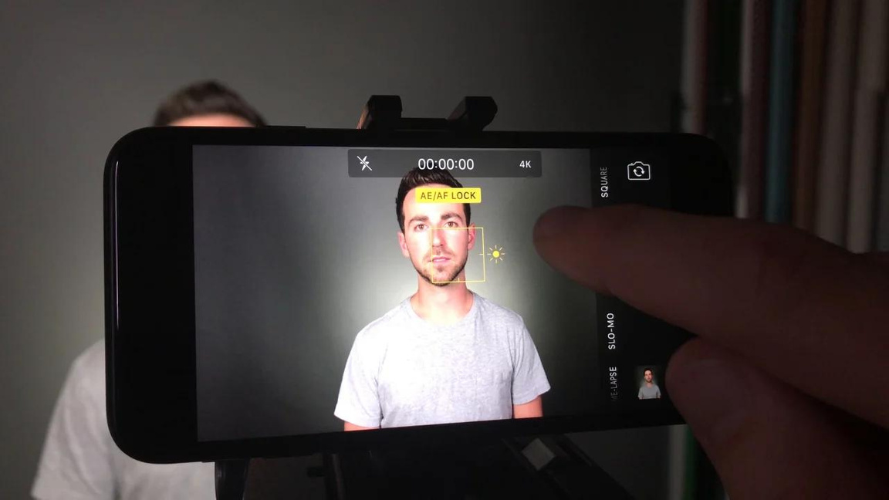
Your Secret
Weapons.
21

Slide 22
Pillar 2: Social Media Recap
Increase Visibility.
Best the Master of a Few.
Develop Your Community.
22

Slide 23
Pillar 3:
Content Strategy
Develop your content strategy, choose your channels, and get consistent messaging.
23

Slide 24
24
Developing a
Content Strategy
ESTABLISH YOUR CONTENT GOALS.
DEVELOP YOUR CONTENT BUCKETS.
DEVELOP YOUR SCHEDULE.
BE CONSISTENT.

Slide 25
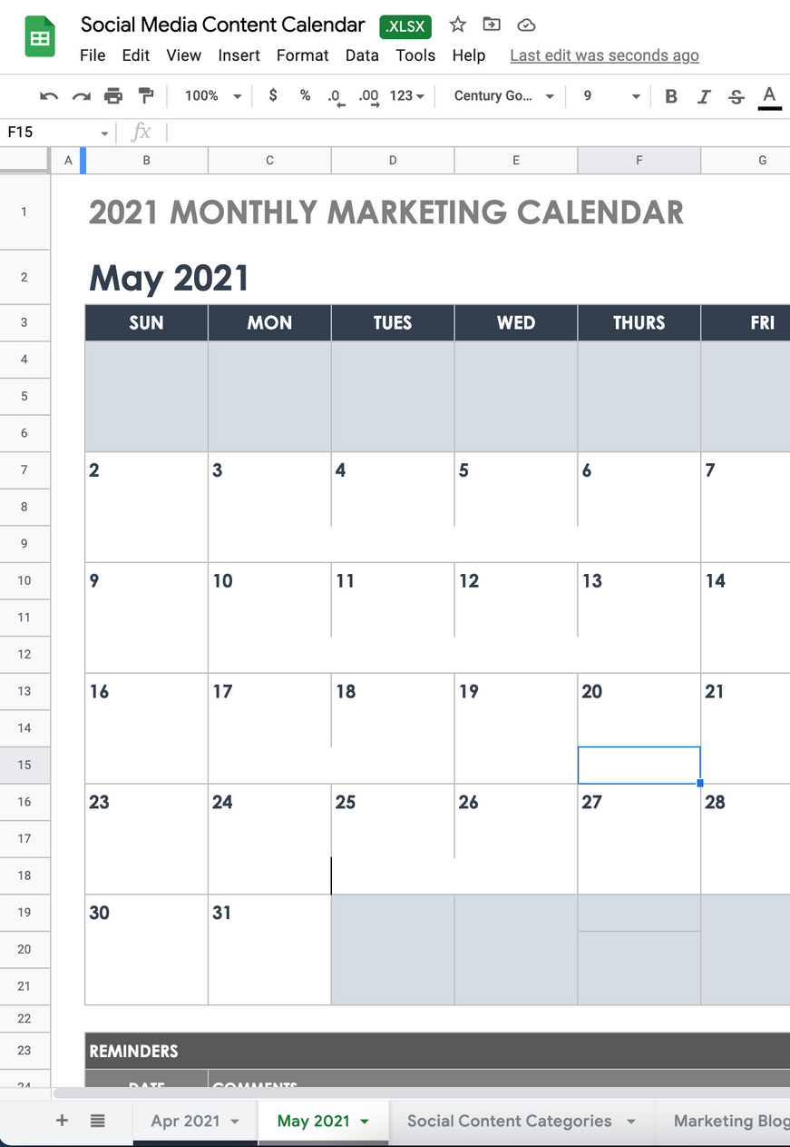
Scheduling
is Key.
VISIT
gokeysource.com/glar
AND PICK UP OUR FREE CONTENT
CALENDAR TEMPLATE WITH CONTENT BUCKETS AND IDEAS!
25

Slide 26
Pillar 3: Content Strategy
Build Your Schedule.
Stay Consistent.
Study What Works & What Doesn't.
26

Slide 27
It's Time to Get Started!
ITS TIME TO LEVEL UP YOUR DIGITAL MARKETING
FOLLOW ME AT @TOP.LOUISVILLE.AGENT
27

